Slide 1




AI Powered Content Moderation
TG08001947
Author 1
Photo
Author 2
Photo
Author 3
Photo
Author 4
Photo
Deepika T R
Deepthi K
Nishanth K J
Skanda P M
Maharaja Institute of Technology Mysore
Mysore
Dr. Victor Ikechukwu Agughasi

Slide 2

Challenge Statement
Design and implement an AI-powered content moderation system capable of real-time detection, analysis, and management of inappropriate, harmful, or restricted content across text, image, and video formats on multimedia platforms.
The system must harmonize the precision of automated AI models with the contextual understanding of human oversight, ensuring compliance with international copyright laws, cultural norms, and community standards.

Slide 3
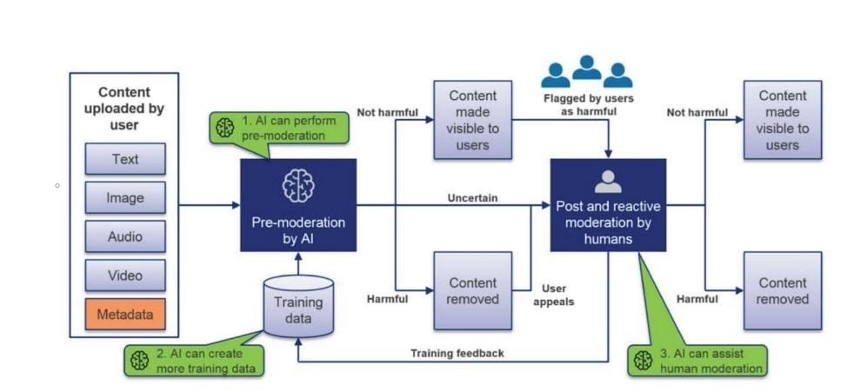
Concept / Solution - 1
Concept
The AI-Powered Content Moderation System addresses the growing challenge of managing harmful and inappropriate online content through an advanced, technology-driven approach.
It integrates real-time detection, human oversight, and adaptive learning to effectively filter and manage content across text, images, audio, and video.
The system ensures fairness, cultural sensitivity, and global compliance by leveraging cutting-edge AI techniques, human collaboration, and robust analytics tools. It promotes transparency, user trust, and safer digital environments while supporting content creators with actionable insights and solutions.

Slide 4
Concept / Solution - 2
Solution: Features:
Input Moderation: Detects harmful text, visuals, audio, and video content.
Reason for Removal: Clearly explains why content is flagged, detailing specific issues (e.g., offensive language or violent imagery).
Deepfake Detection: Identifies and flags manipulated or fake content.
Content Refinement: Suggests compliant edits using generative AI, helping users revise content.
How It Works:
Generative AI: Simulates complex cases and enhances detection accuracy.
Multi-Modal Analysis: Integrates text, images, and audio for context-aware decisions.
Explainable AI: Provides transparent reasons for flagged content.
Human Oversight: Moderators handle complex cases and refine models with feedback.

Slide 5
Pros and Cons of the solution
Pros:
Real-Time Efficiency: Quick content detection and response.
Comprehensive Moderation: Supports text, visuals, audio, and video.
Transparency: Explains flagged content clearly.
Scalability: Handles large content volumes globally.
Adaptability: Customizable for cultural and regional norms.
Human-AI Collaboration: Blends automation with expert oversight.
Generative AI: Suggests fixes and detects deepfakes.
Cons:
False Flags: Misclassifications require refinement.
High Costs: Expensive AI infrastructure.
Cultural Complexity: Challenging to adapt to diverse norms.
Resource Demands: Requires significant computing power.
User Backlash: Risk of dissatisfaction with automated decisions.

Slide 6
Technical Description
Layer | Technologies
Frontend | React, Next.js, Tailwind CSS, Material-UI
Backend | Python (Django, Flask), Node.js (Express.js)
AI Models | NLP (BERT, GPT), Computer Vision (YOLO, Vision Transformers), OpenCV
LLMs | OpenAI GPT, LangChain
Databases | PostgreSQL, MongoDB
Cloud & DevOps | AWS, Google Cloud, Azure, Docker, Kubernetes
Explainable AI | SHAP, LIME
Generative AI | GPT, GANs
Analytics | Tableau, Power BI, Google Analytics
Multimodal AI Integration:
Text Analysis: Detect hate speech, misinformation, and threats using NLP.
Image Processing: Identify explicit imagery, violence, and copyright violations through Computer Vision (CV).
Video Analysis: Frame-by-frame evaluation to detect objectionable sequences and escalating patterns.
Audio Analysis: Speech-to-text conversion and tone analysis to identify offensive language.
Human-AI Collaboration:
AI automates bulk moderation.
Human moderators handle complex or ambiguous cases.
Feedback from moderators improves AI accuracy over time.
Explainable AI (X-AI):
Transparent decision-making with detailed explanations for flagged content.
Builds user trust through clear, explainable moderation processes.
Generative AI:
Suggests edits for flagged content to help users meet guidelines.
Detects and mitigates synthetic media like deepfakes.

Slide 7
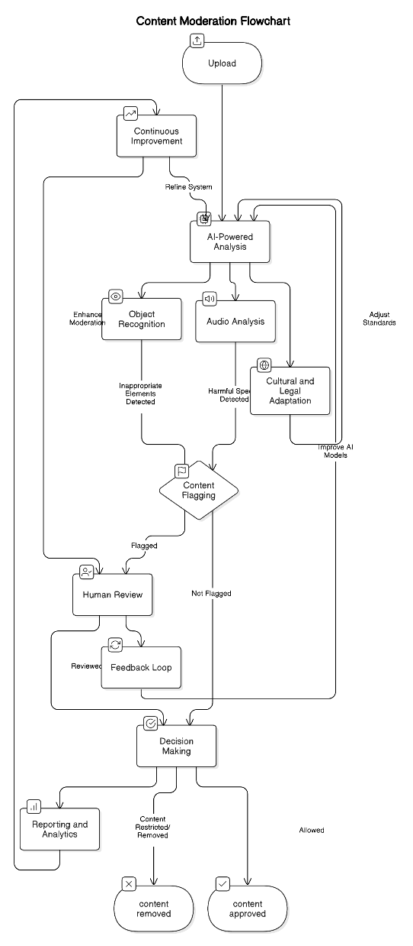
Technical Description
Upload: Users submit content (text, images, audio, video).
AI Analysis:
Object Recognition: Flags inappropriate visuals.
Audio Analysis: Detects harmful speech.
Cultural Adaptation: Ensures regional compliance.
Content Flagging: AI flags content for review or approves it.
Human Review: Moderators handle flagged content, providing decisions and feedback.
Feedback Loop: Human inputs improve AI accuracy.
Decision Making: Content is either approved or removed.
Reporting & Analytics: Dashboards monitor flagged trends and system performance.
Continuous Improvement: Feedback refines AI models and processes.

Slide 8
Implementation Plan
Planning:
Define objectives (e.g., detecting hate speech, violence).
Identify AI model needs and set ethical guidelines with stakeholders.
Data Collection:
Gather public datasets and anonymized user content.
Categorize (text, images, videos, audio) and annotate using tools like Label box.
Preprocessing:
Clean, normalize, and split data (70% training, 20% validation, 10% testing).
Model Training:
Text Analysis: Fine-tune GPT/BERT on labelled datasets for offensive language and misinformation detection.
Image Analysis: Fine-tune YOLO on custom image datasets for explicit content and violence detection.
Audio Analysis: Fine-tune Whisper with harmful speech and transcription datasets.
Video Analysis: Fine-tune 3D CNN's (I3D/C3D) using objectionable video sequences for frame-level detection.
Train all models on GPUs/TPUs and validate with F1-score, precision, and recall metrics.
Deployment:
Deploy models using TensorFlow or PyTorch and scale with AWS/Kubernetes.
Continuous Improvement:
Retrain models using feedback and monitor performance for updates.

Slide 9
Implementation Plan
Areas of Implementation:
Social Media Platforms: Moderate content on Facebook, Instagram, Twitter, and TikTok.
Video Streaming Services: Ensure guideline compliance on YouTube, Netflix, and Twitch.
E-Commerce Sites: Review user content on Amazon, eBay, and similar platforms.
Educational Platforms: Moderate resources on Coursera, Udemy, and Khan Academy.
Gaming Platforms: Filter chats and uploads on Discord, Steam, and PlayStation Network.
News Portals: Detect fake news and filter harmful comments.
Corporate Tools: Moderate messages and files on Slack, Teams, and Zoom.
Online Forums: Ensure respectful discussions on Reddit and Quora.
Customer Support: Automate offensive language removal in chatbots and emails.
Government Use: Monitor public platforms for legal and cultural compliance.

Slide 10
Validation / Testing / Analysis
Validation:
Use metrics like Precision, Recall, F1-Score, and Accuracy.
Validate models on 20% unseen data to ensure accuracy and reliability.
Testing:
Unit Testing: Test individual components (e.g., text, image, audio, video models).
Integration Testing: Verify interaction between AI models and APIs.
System Testing: Check the full moderation workflow from upload to decision-making.
Stress Testing: Simulate high upload volumes to evaluate scalability.
Edge Case Testing: Test ambiguous or borderline content for robustness.
Analysis:
Review False Positives/Negatives and refine thresholds.
Incorporate flagged content for retraining models.
Monitor and analyse performance trends to enhance future iterations.

Slide 11
Cost Estimate
Cost Component | Description | Estimated Cost (INR)
Data Collection | Using open-source datasets like Jigsaw Toxicity or Open Images for free. | ₹0 (Assume free)
Model Fine-tuning | Leveraging free tiers of cloud platforms (Google Colab or Hugging Face) for small-scale fine-tuning. | ₹5,000 - ₹10,000
API Integration | Using free or open-source libraries for integration (Flask, FastAPI). | ₹2,000 - ₹5,000
Cloud Hosting | Utilizing free credits from cloud providers (AWS, GCP, Azure) for hosting. | ₹0 - ₹5,000
Testing & Validation | Manual testing using small, curated datasets. | ₹1,000 - ₹2,000
Miscellaneous Costs | Internet, minor hardware expenses, or other unforeseen costs. | ₹2,000
Total Estimated Cost | Approximate cost to build and test the prototype. | ₹10,000 - ₹20,000

Slide 12
Assumptions
Improved Content Quality: Reduces harmful, offensive, or misleading content.
Enhanced User Experience: Ensures a clean, safe, and inclusive media environment.
Higher Moderation Efficiency: Automates bulk moderation, speeding up reviews.
Better Compliance: Adheres to legal and ethical standards like GDPR.
Adaptability: Stays effective against threats like deepfakes with continuous learning.
Increased Trust: Builds trust with transparent and explainable AI decisions.
Cost Efficiency: Reduces long-term operational costs through automation.
Scalability: Handles growing content volumes efficiently.

Slide 13
References
Anchal Pandey, Sukumar Moharana, Debi Prasanna Mohanty, Archit Panwar, Dewang Agarwal, and Siva Prasad Thota: "On-Device Content Moderation.“
K, Ananthajothi, Meenakshi R, and Monica S. Promoting Positive Discourse: Advancing AI-Powered Content Moderation with Explainability and User Rephrasing.
Arjun Mantri:Real-Time Content Moderation Using Artificial Intelligence and Machine Learning
Singhal, Mohit, Chen Ling, Pujan Paudel, Poojitha Thota, Nihal Kumarswamy, Gianluca Stringhini, and Shirin Nilizadeh. "SoK: Content Moderation in Social Media, from Guidelines to Enforcement, and Research to Practice."
Heba Saleous, Marton Gergely, and Khaled Shuaib. "Utilization of Artificial Intelligence for Social Media and Gaming Moderation."

Slide 14
THANK YOU ☺

